Slide 1
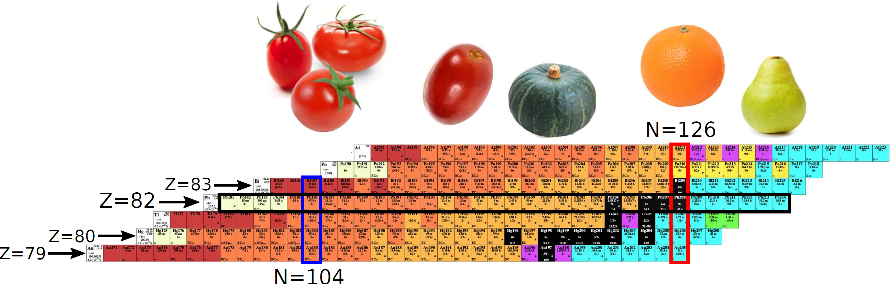

The studies of neutron-rich Tl-Po isotopes facilitated by selective laser spectroscopy at ISOLDE Decay Station (CERN)
(nice physics with modern experimental nuclear and atomic techniques)
Andrei Andreyev
University of York(UK)
Introduction on shapes and charge radii
Method: Isotope Shift(IS) and Hyperfine Splitting (HFS) measurements
ISOLDE and our detection tools
Exemplary study case: neutron-deficient Hg isotopes – is there life after shape
staggering?
N=126 charge radii kink problem
Neutron-rich Tl and Hg isotopes
Conclusions
Image courtesy J.Cubiss

Slide 2
Collaboration
University of York, United Kingdom
A. N. Andreyev, J. G. Cubiss, R. Harding, C. Raison, C. Page, Z. Yue... Université Paris-Saclay
S. Hilaire, S. Péru,
Universite Libre de Bruxelles S. Goriely
Gatchina, JINR-Dubna, Russia I. N. Borzov, A. E. Barzakh, D. V. Fedorov, P. Molkanov
RILIS, CRIS and ISOLDE, Geneva, Switzerland
B. A. Marsh, K. Chrysalidis, R. Heinke, C. Bernerd, V. N. Fedosseev, M. D. Seliverstov, K. Lynch, T. Day Goodacre...
Institut für Physik, Johannes Gutenberg-Universität Mainz, Mainz, Germany S. Raeder, K. D. A. Wendt
Instituut voor Kern- en Stralingsfysica, K.U. Leuven, Leuven, Belgium
S. Sels, L. Ghys, C. Van Beveren, E. Rapisarda, D. Pauwels, D. Radulov, H. De Witte,
Yu. Kudryavtsev, M. Huyse, P. Van Duppen, K. Rezynkina, L. Gaffney, T. E. Cocolios...
Comenius University, Bratislava, Slovakia
S. Antalic, B. Andel....
MR-TOF@ISOLTRAP team:
S. Kreim, V. Manea, F. Wienholtz, M. Meugeot, M. Rosenbusch, L. Neis +...
Univeristy of Surrey, United Kingdom Z. Podolyak, S. Pascu... University of Manchester, UK J. Billowes, M. Bissel…
Many PhD students, both nuclear and atomic/laser spectroscopy

Slide 3
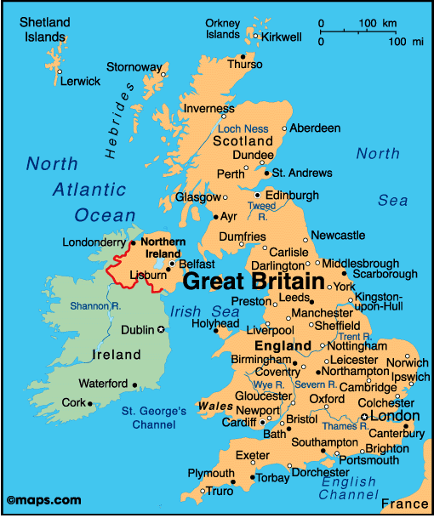
York city, UK, ~150.000 population
University of York (est. 1963)
Academic staff | 2,295
Students | 23,420
Undergraduates | 15,350
Postgraduates | 8,070
York’s Nuclear Physics group
10 academics
10+ postdocs
25+ PhD students

Slide 4
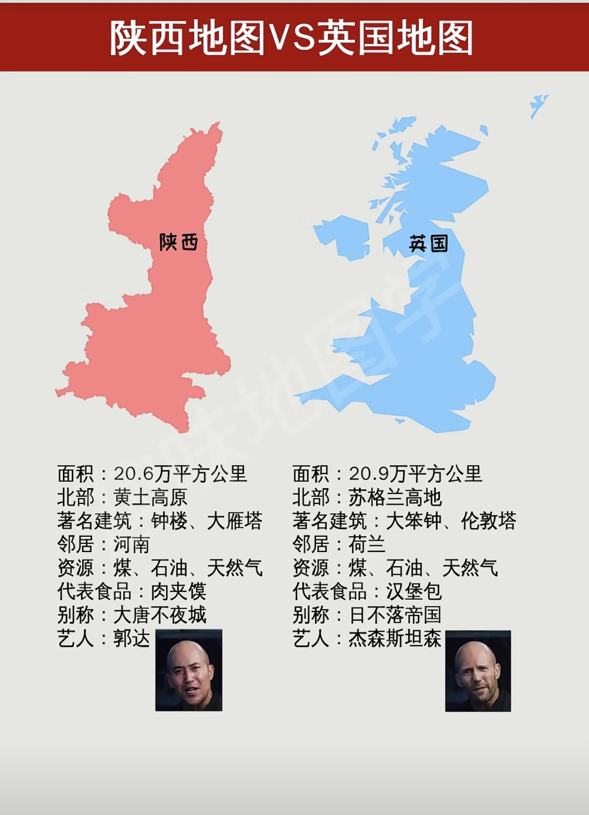


Some fun ☺
35 million
69 million
https://www.chinacheckup.com/blog/comparing-shaanxi-britain

Slide 5
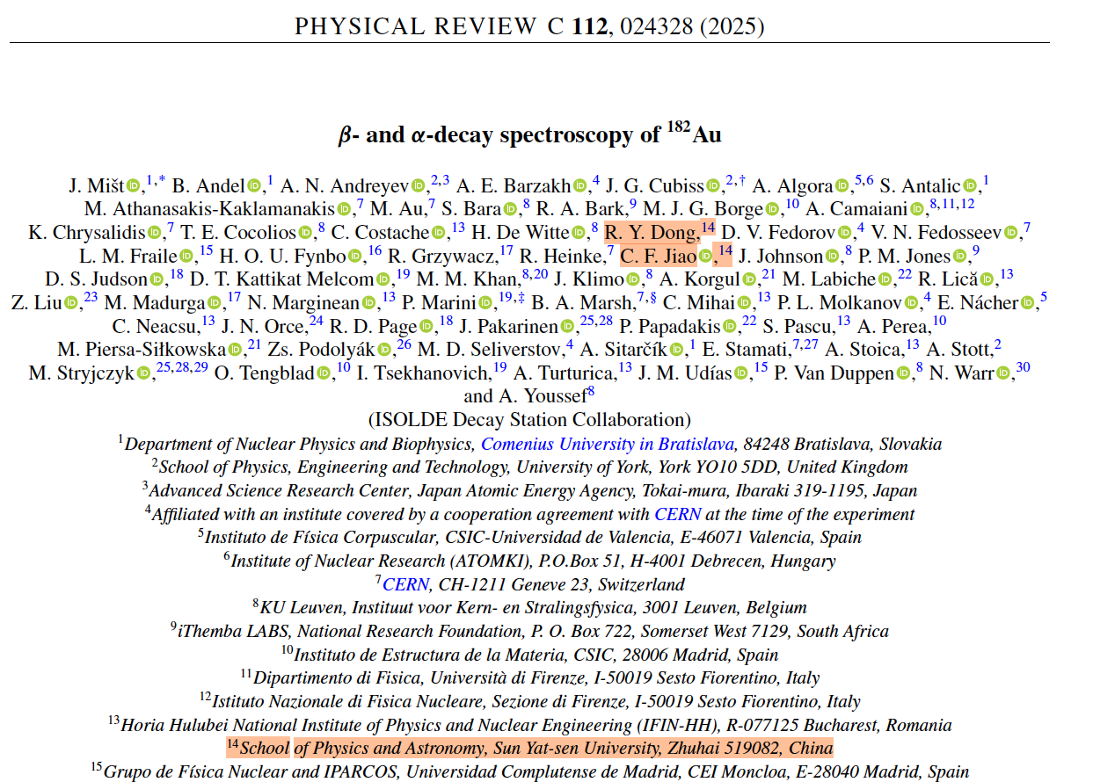
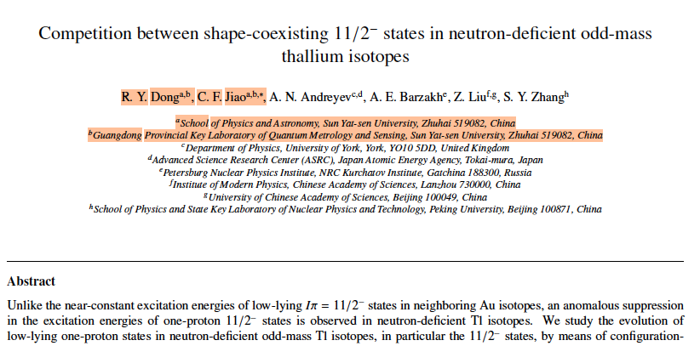
York-Zhuhai Collaboration:
Nuclear structure in heavy exotic nuclei (C.F.Jiao et al )
August 2025
In preparation 2026

Slide 6
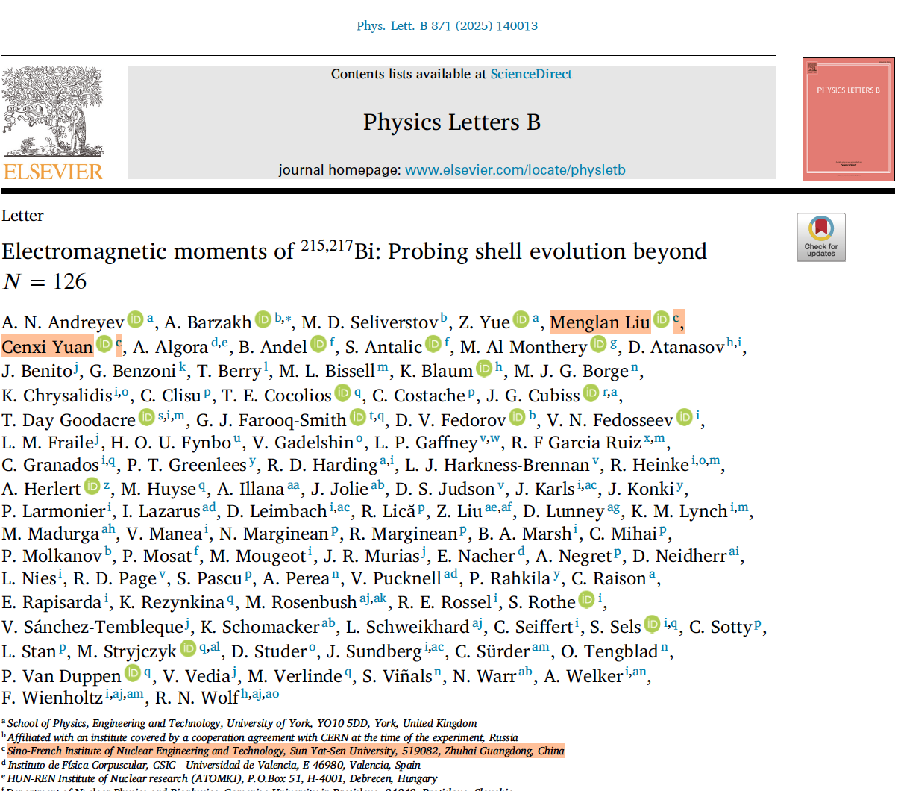
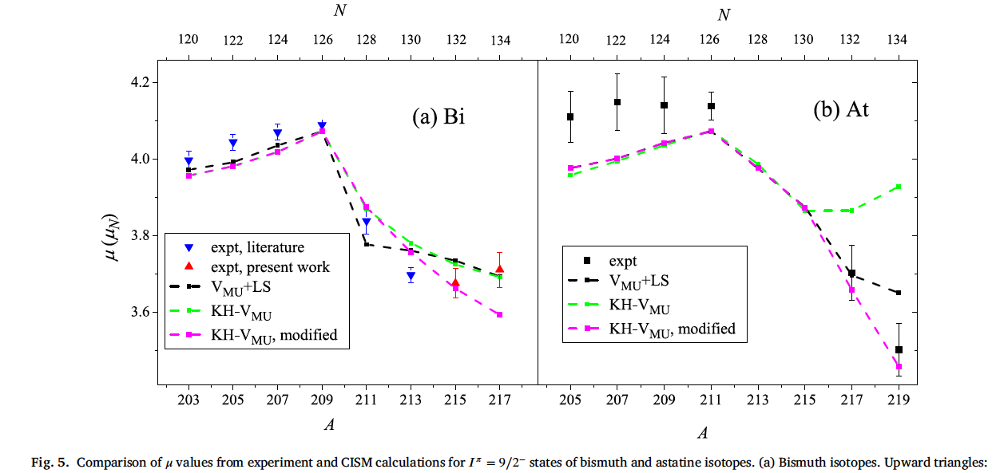
York-Zhuhai Collaboration:
Probing the shell evolution in heavy nuclei (C.Yuan et al.)
November 2025

Slide 7
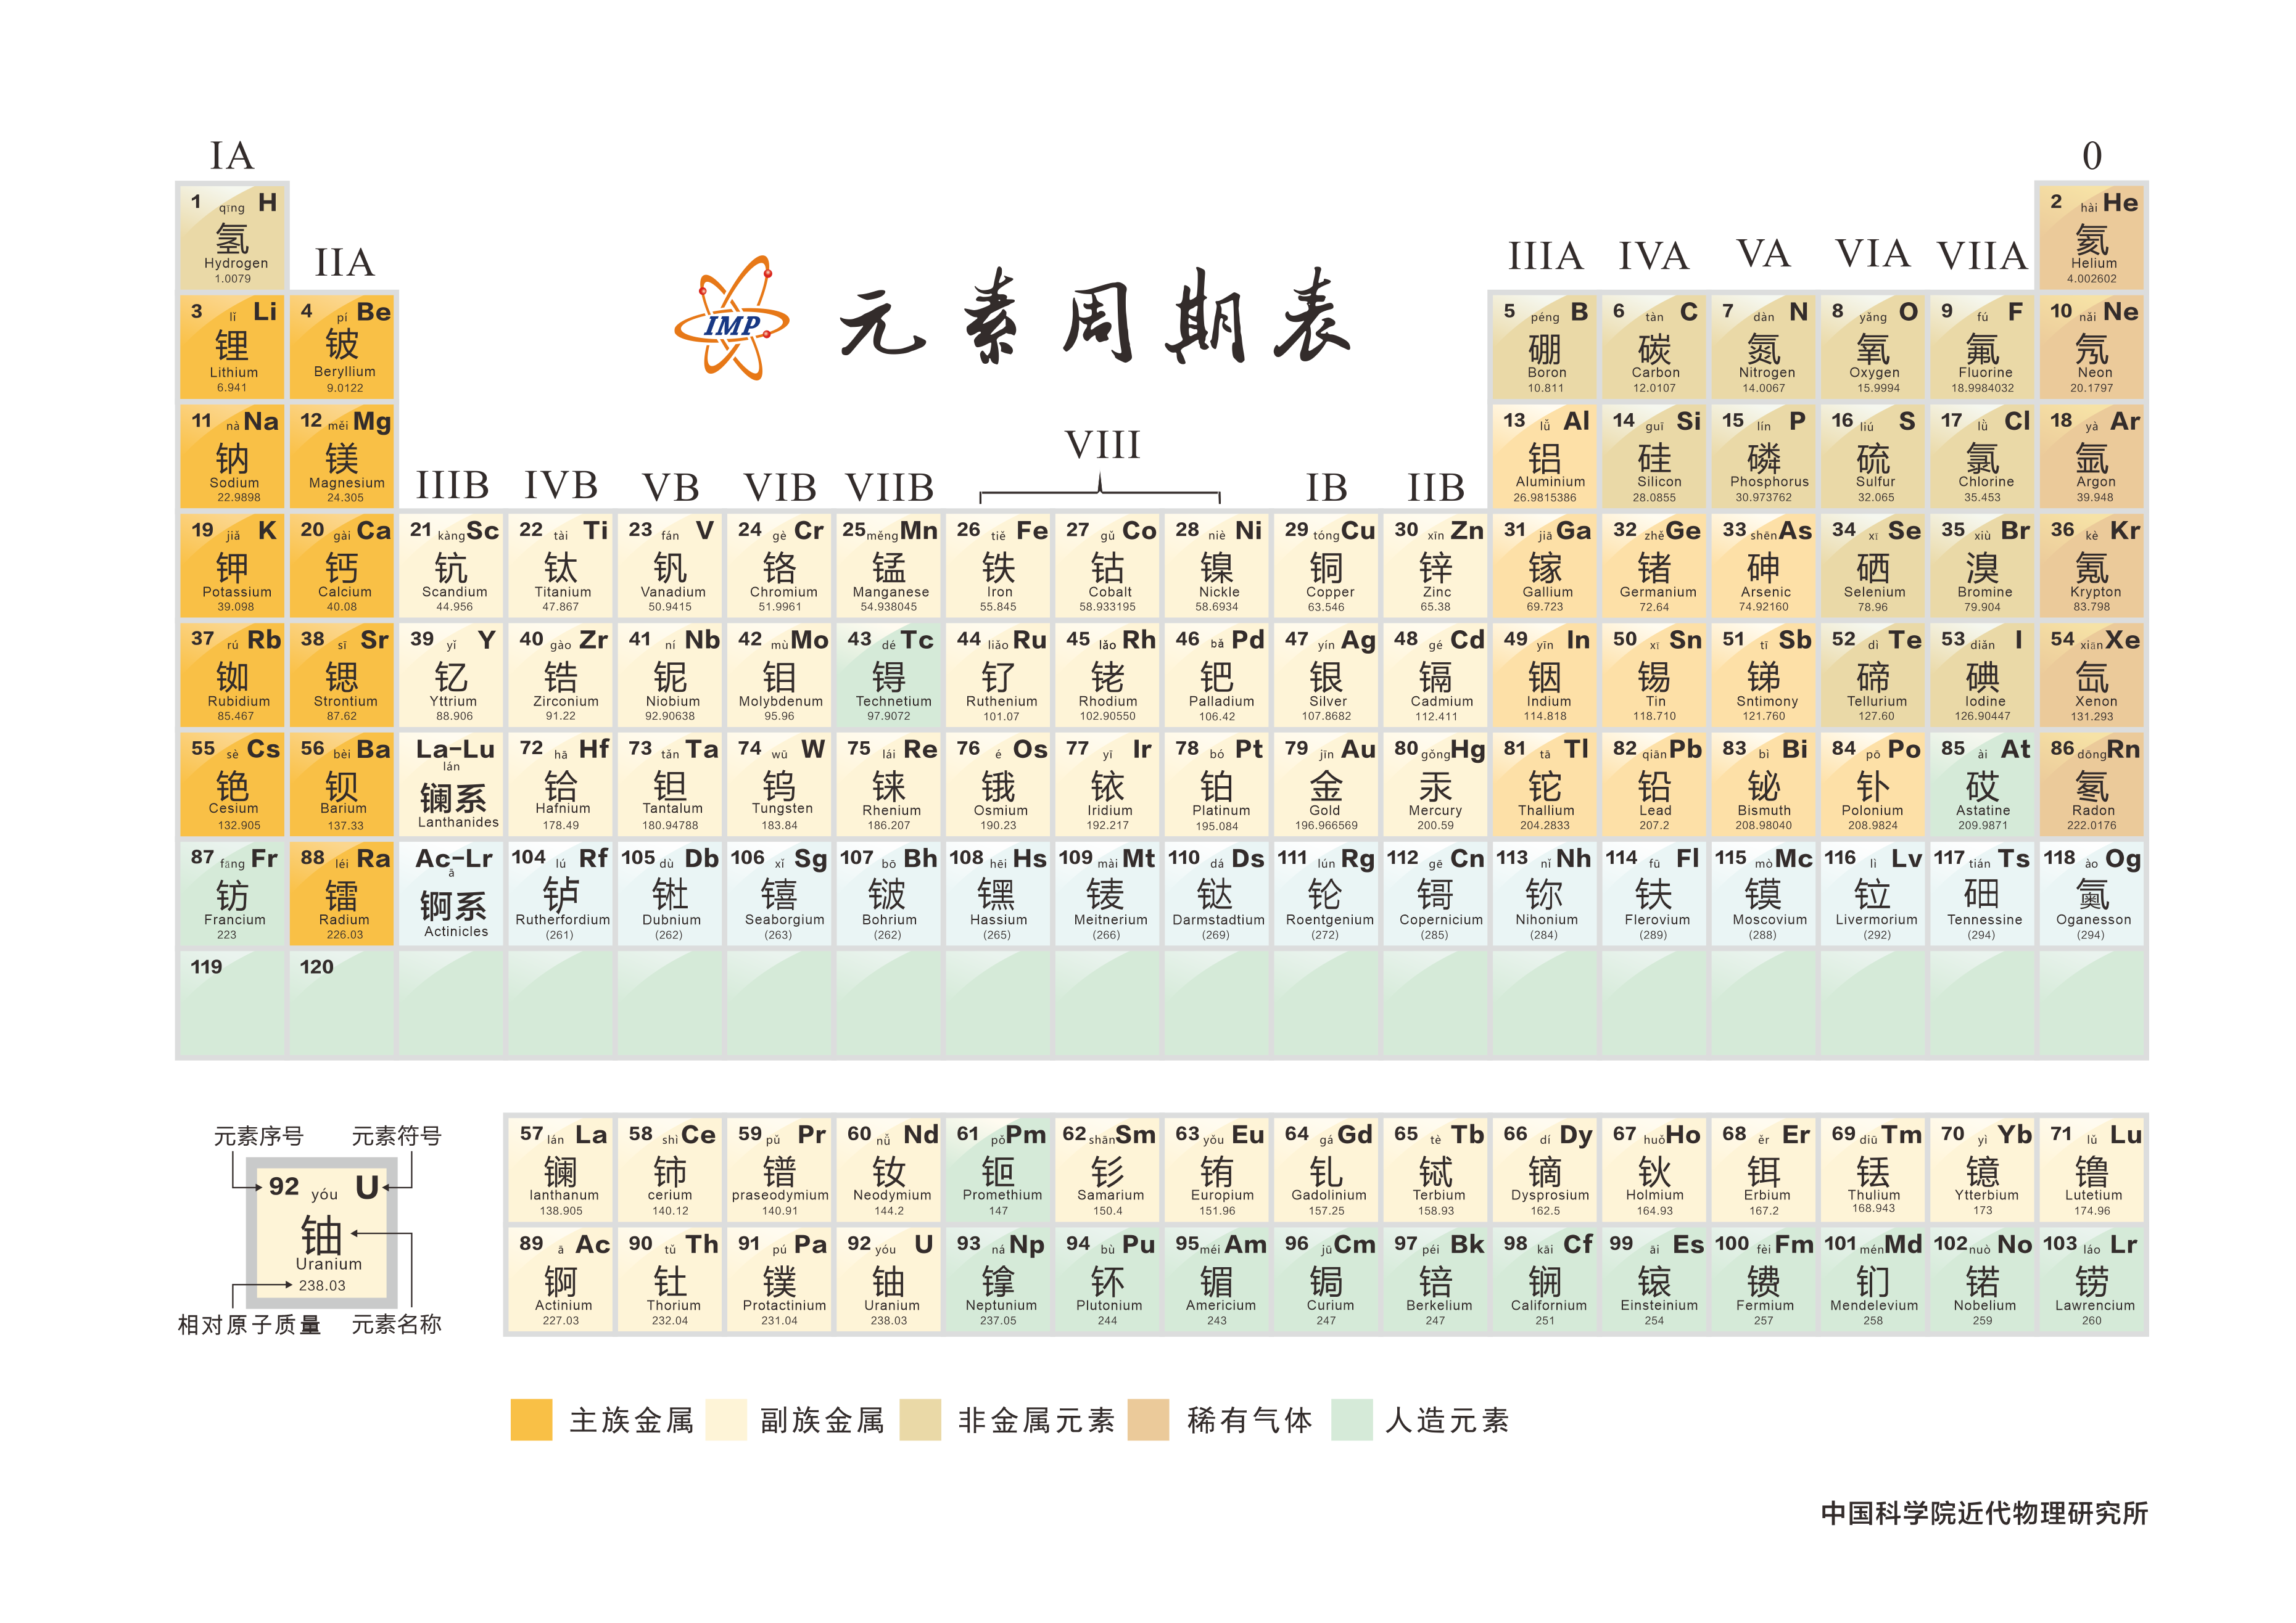
Mendeleev’s Chart of Elements (a chemist’s point of view)
118 elements are known so far

Slide 8
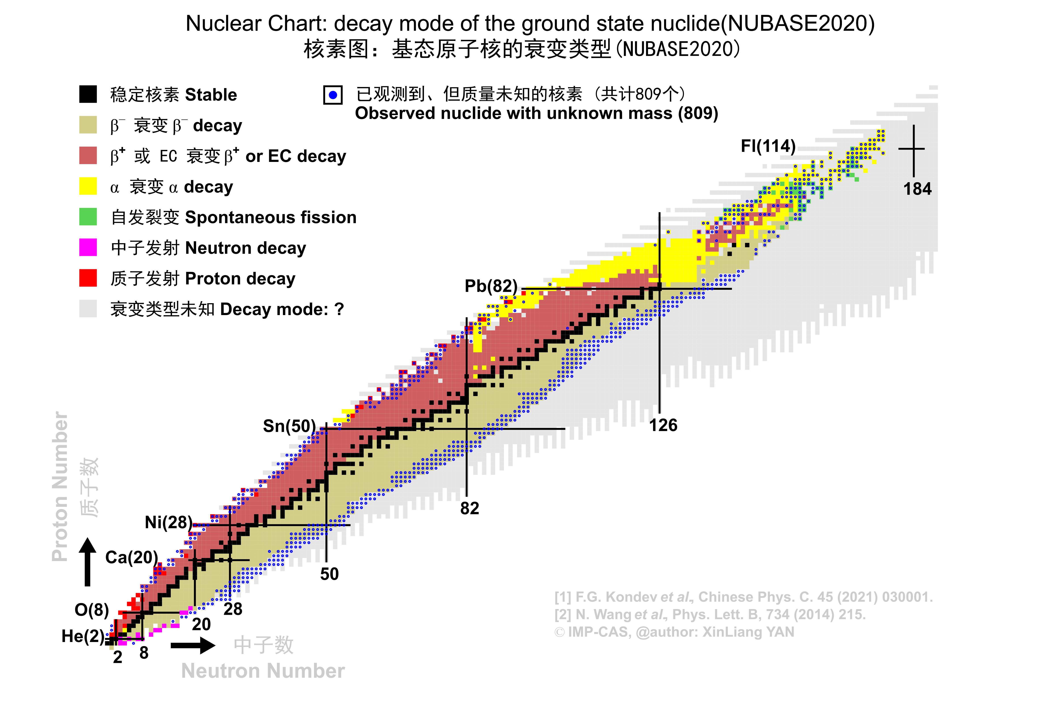
Chart of Isotopes (a nuclear physicist’s point of view)
283 stable isotopes
Og(Z=118)
~3300 isotopes are known,
~4000 can be discovered,
including new elements
A key question: are the underlying physics phenomena the same for very exotic (neutron-deficient or neutron-rich) isotopes as for stable isotopes?

Slide 9
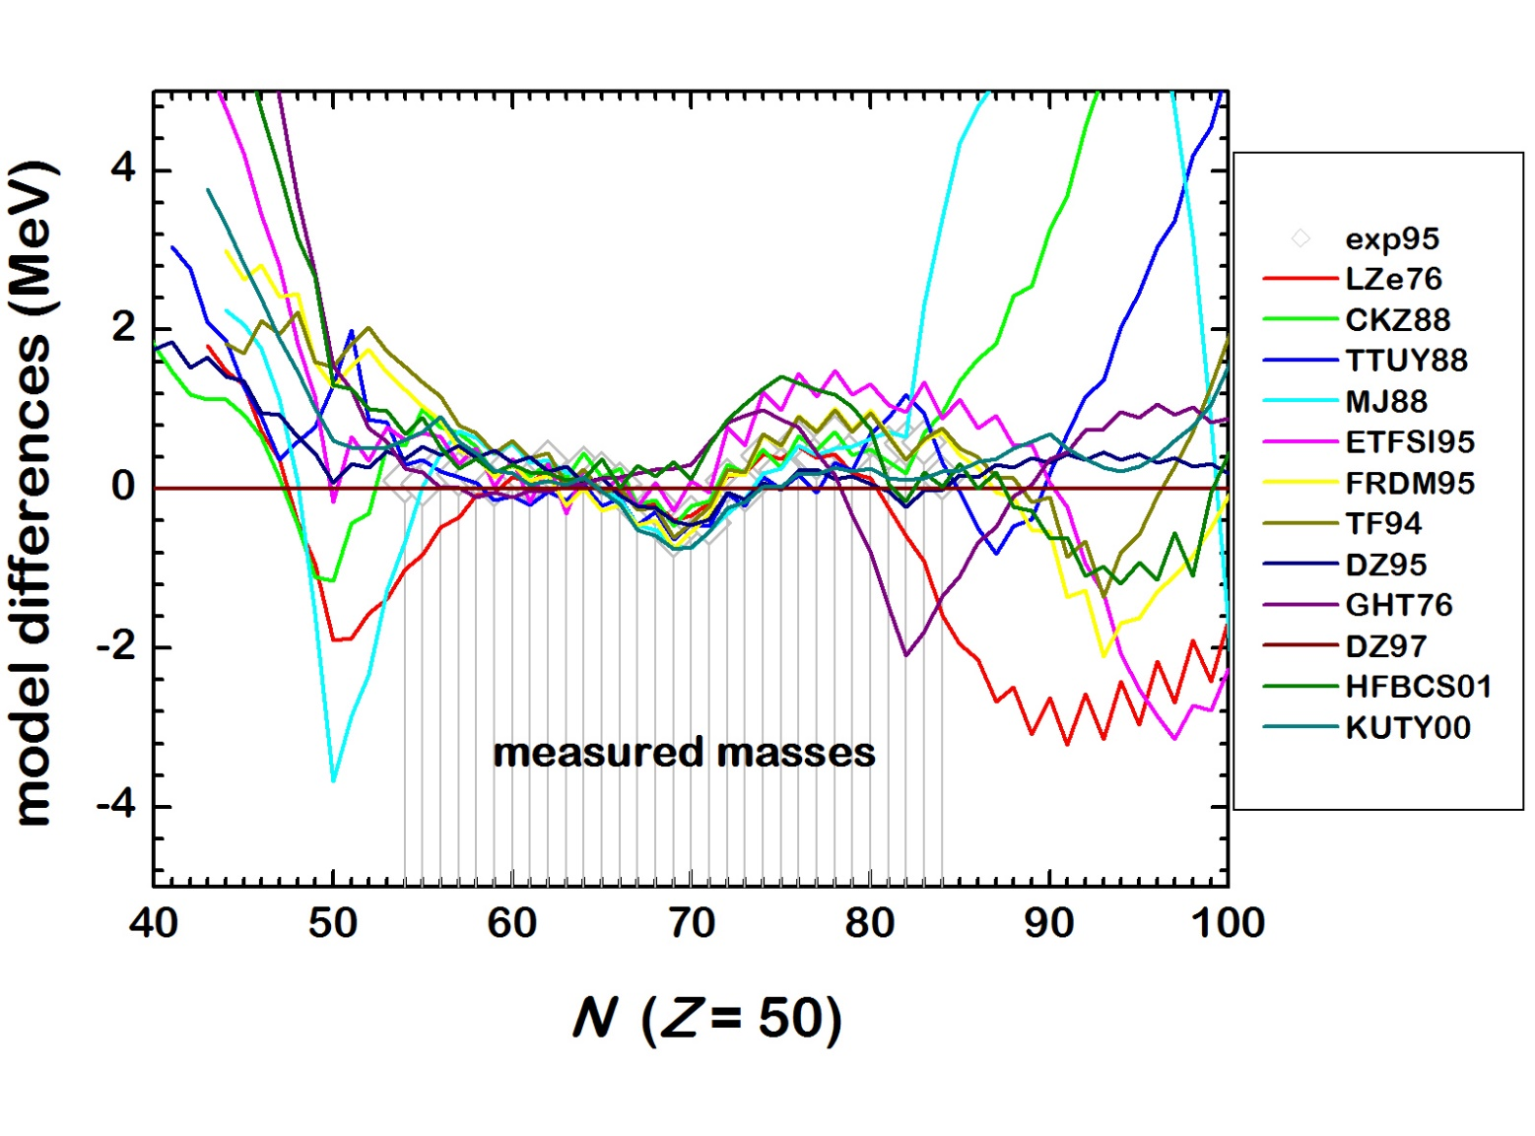
Example: Calculations of mass for Sn isotopes (or why we need to go far off stability)
¹⁰⁰Sn
¹³²Sn
Stable
Courtesy D. Lunney

Slide 10
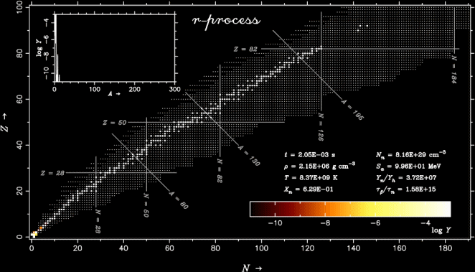
R-process network calculations
r-プロセス元素合成の動画
²³²Th,²³⁸U
¹³²Sn
⁷⁸Ni
和南城伸也氏（上智大）
R-process network calculations require data for very neutron-rich nuclei: half-lives, decay modes, neutron-capture cross sections, fission barriers and mass distributions.

Slide 11
(Basic) Introduction on Nuclear Radii and Shapes Or is R=r_{o}A^{1/3}? (as it is said in all textbooks)

Slide 12
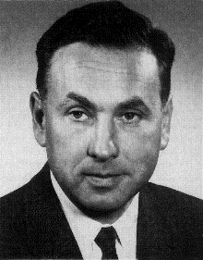
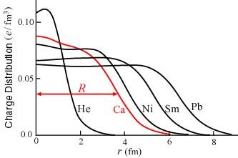
Traditional Techniques to Measure Charge Radii/Densities of Nuclei
1915-1990
https://www.nobelprize.org/uploads/2018/06/hofstadter-lecture.pdf
Review of Modern Physics, 28,1956
Electron Angular Distribution
also as a function of e⁻ energy
Charge Distribution
Charge Radius R
R=r_{o}A^{1/3}
Measurements of Muonic X rays – also charge distributions
Optical Isotope Shift (IS) measurements for stable isotopes – provide radius
Electron scattering/Muonic X rays provide absolute charge radii/densities for STABLE/LONG-LIVED isotopes, but both methods require large amount of material (often many mg’s)
Modern experiments with UNSTABLE isotopes allow the use of IS measurements for short-lived nuclides, up to ~ a few ms (depends on intensity), up to 0.01 pps!
Also, the electron scattering on RIBs in colliding geometry started (SCRIT@RIKEN)

Slide 13
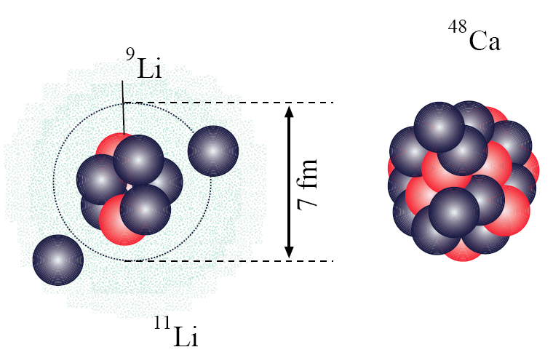
Radioactive Ion Beams (RIBs): Breaking Old Rules in Nuclear Physics:
Is R=r_{o}A^{1/3} ?
¹¹Li (Z=3,N=8)
(halo nucleus)
⁴⁸Ca (Z=N=20)
If R=r_{o}A^{1/3} then D(⁴⁸Ca)/D(¹¹Li)=2*(48/11)^{1/3}~3.2

Slide 14
RIBs: Breaking Old Rules in Nuclear Physics: is R=r_{o}A^{1/3} ?
Nuclear Radii
Z
N
Courtesy I.Tanihata

Slide 15
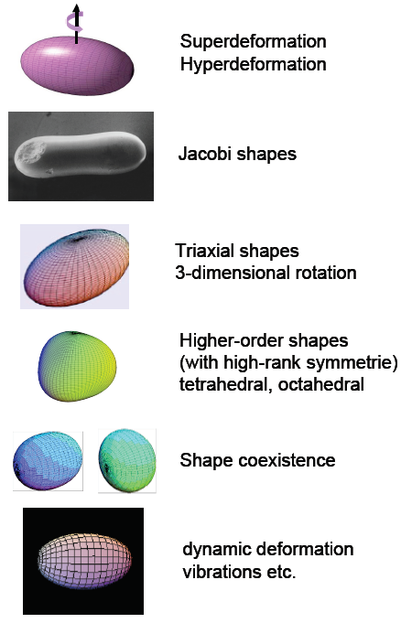
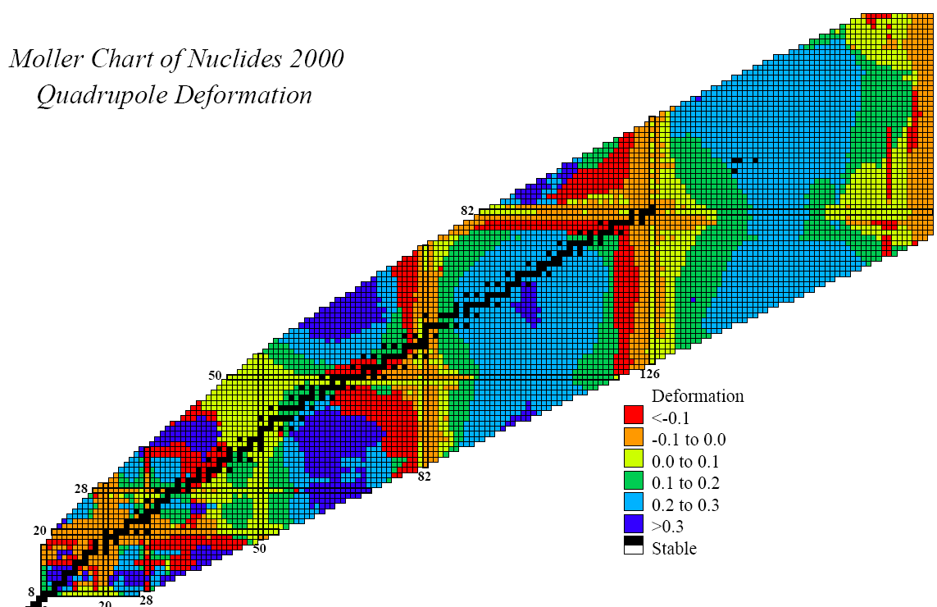
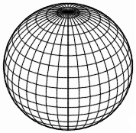
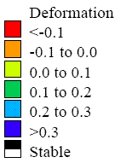


Shapes and Deformations of Atomic Nuclei
Moller Chart of Nuclides 2000
Ground state β₂ deformation
http://ie.lbl.gov/systematics
OBLATE
N=126
⇓
PROLATE
Pb (Z=82) ⇒
Sn (Z=50) ⇒
SPHERICAL
e.g. doubly-magic
Z
⇑
N=82
⇑
N=50
N

Slide 16
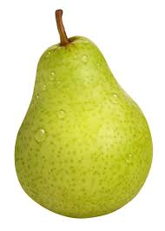

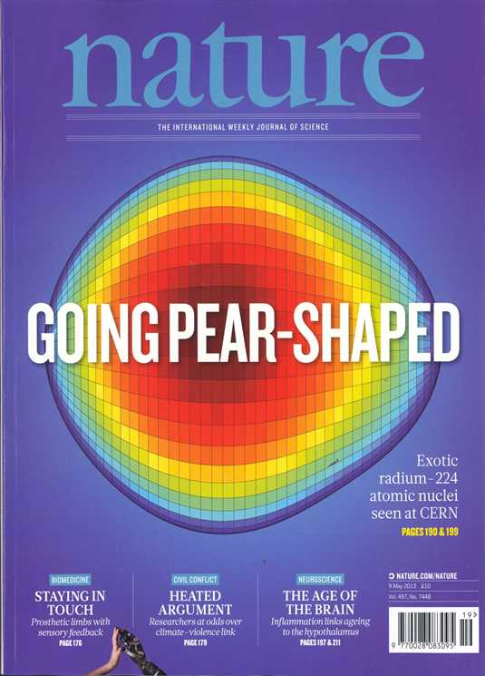
Pear-Shaped Nuclei?
Studies of pear-shaped nuclei using accelerated radioactive beams
L. P. Gaffney et al. Nature 497, 199 (2013)

Slide 17
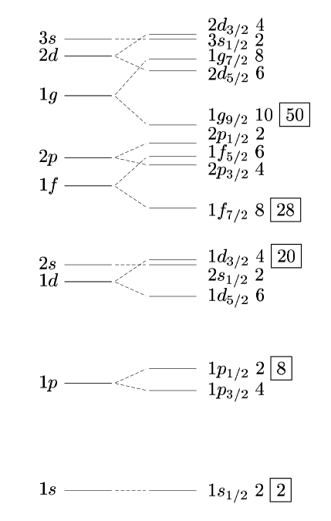
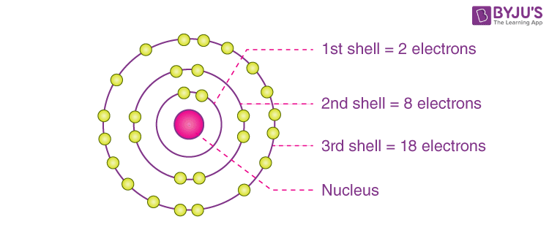
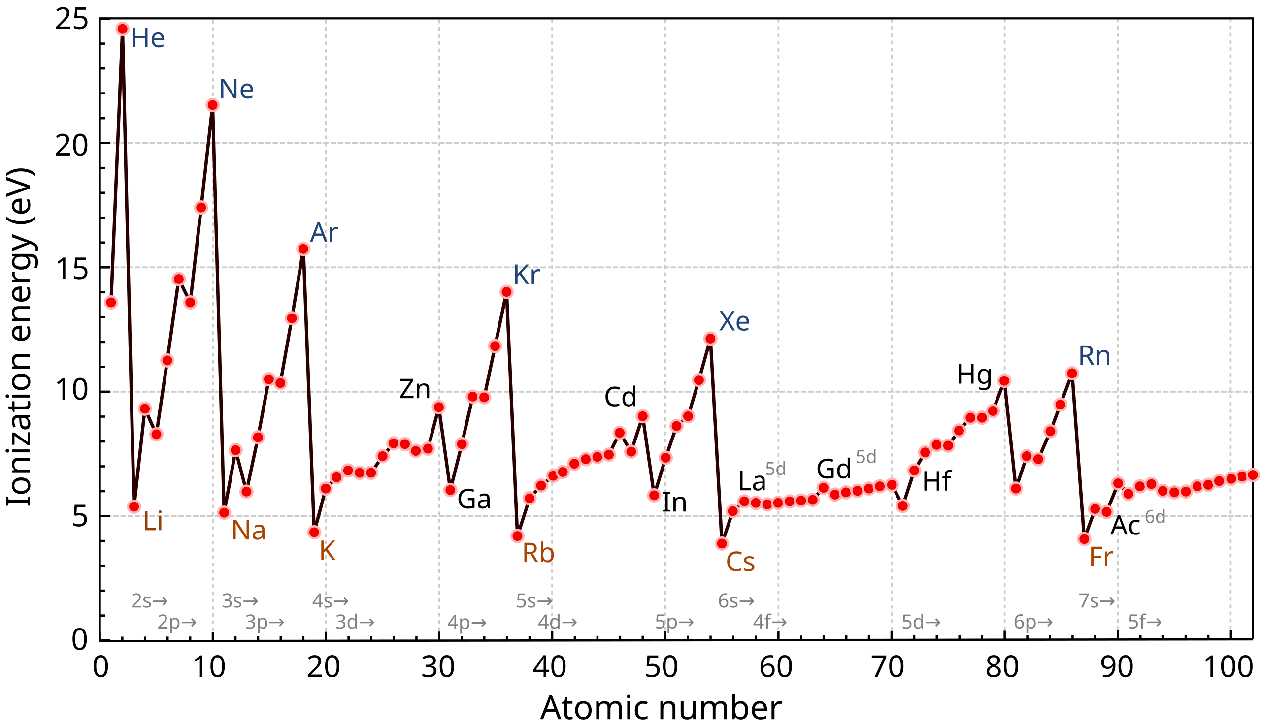
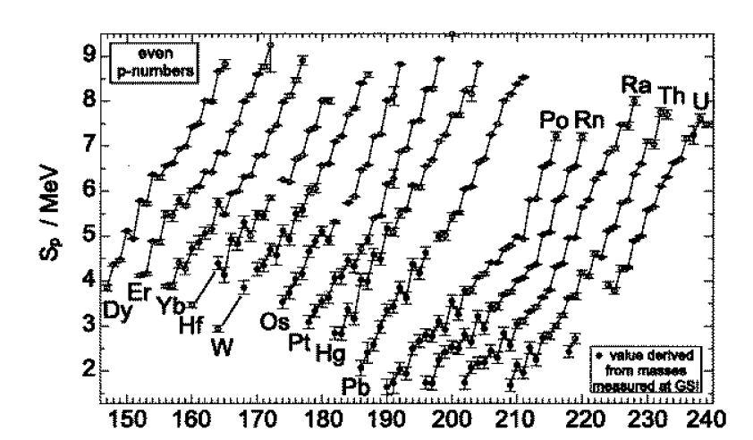
A reminder: Shell Model Structure in atoms and nuclei
Atoms: Energy scale – eV/keV’s
Shell structure, magic numbers 2,10,18,36…
Nuclei: Energy scale – keV’s/MeV’s
Magic numbers:2,8,20,28,50,82, 126
Atom’s ionization energies (eV)
Proton separation energies (MeV)

Slide 18
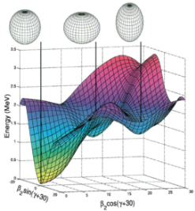
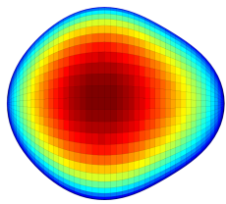
Laser-assisted Nuclear Spectroscopy Studies
in the neutron-rich Tl-Po nuclei at ISOLDE-CERN
(nice physics with modern experimental nuclear and atomic techniques)
Shape coexistence around N~104 (coexistence of several shapes)
Sphericity around N=126, kink in radii, high-spin isomers
Octupole effects around N~132, inverse odd-even radii staggering
Image courtesy J.Cubiss

Slide 19
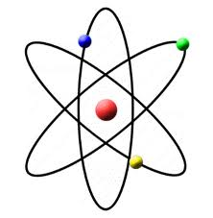
Experimental Probes
Fusion evaporation, Fragmentation, Fission, Deep inelastic scattering,
Knock-out …
Energy
T_{1/2}
I^{π}
^{A}Y
Gamma spectroscopy
Few-nucleon transfer
Radioactive decay
^{A-1}X (d,p)
Coulomb excitation
I^{π}
Laser spectroscopy,
Magnetic/quadrupole
moments
Mass spectroscopy
^{A}X

Slide 20
Pre-2003: Charge Radii in the Lead Region
Very large jump between ^{183,185}Hg and ¹⁸⁷Hg
J. Bonn et al, PLB38 , 308 (1972)
R~A^{1/3}
Shape coexistence around N~104
Sphericity around N=126, kink in radii, high-spin isomers
Octupole effects around N~132, inverse odd-even radii staggering

Slide 21
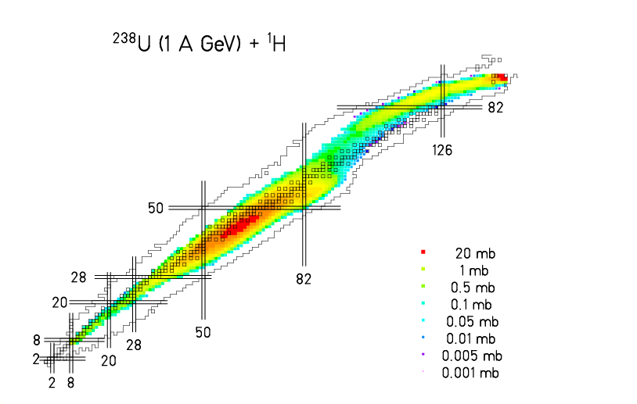
Thick Targets ISOL Method: RIBs Production Reactions at ISOLDE (CERN) induced by p(1 GeV) on a thick Uranium Target
spallation
+
^{180Hg}
spallation
p(1 GeV)
fragmentation
+
+
¹¹Li
X
2
3
8
U
50 g/cm²
fission
fission
+
+
Y
fragmentation
¹⁴⁴Cs
One can use different (lighter) targets, e.g La,W to produce lighter elements
Chemically-selective - not all elements can be extracted (e.g. refractory elements are difficult)
Half-life limitations (>10-20 ms, often >100 ms), limited by diffusion through thick target
Hundreds of isotopes produced simultaneously, need a separator!
Similar method is used at TRIUMF (Vancouver, Canada), they use 500 MeV protons

Slide 22
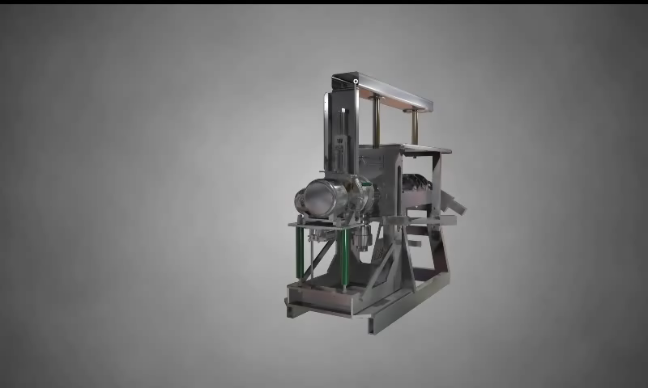
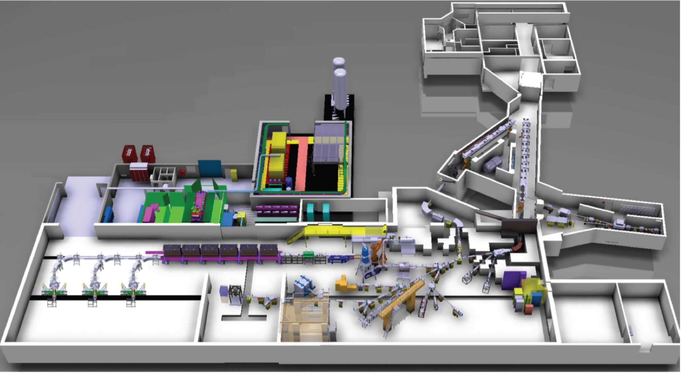
The ISOLDE facility at CERN
HRS Target
1.4 GeV Protons
From PSB
RILIS
GPS Target
WISARD
NICOLE
TAS
VITO
collections
MINIBALL
MR-ToF
Windmill
IDS
CRIS
COLLAPS

Slide 23
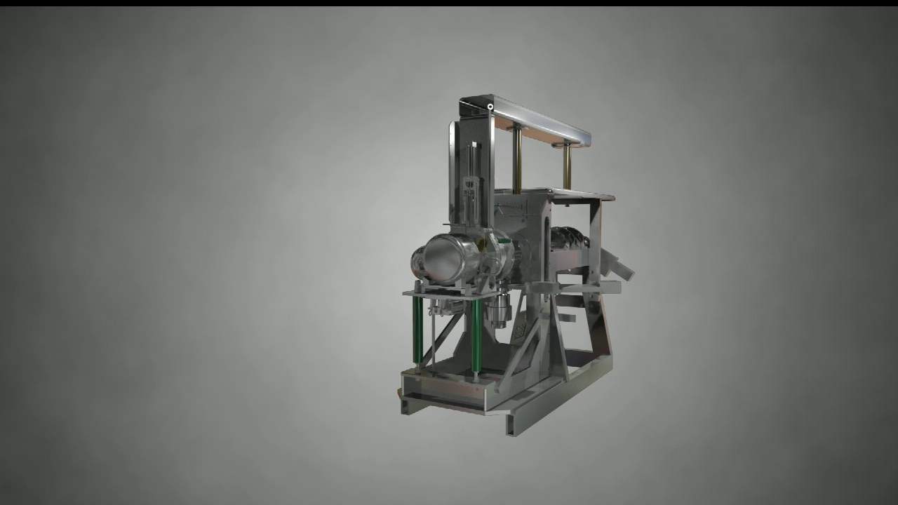
ISOLDE Facility (CERN, Geneva)
(example of a surface-ionization ion source)

Slide 24
ISOLDE Target Unit (with Quartz transfer line)
Proton beam

Slide 25
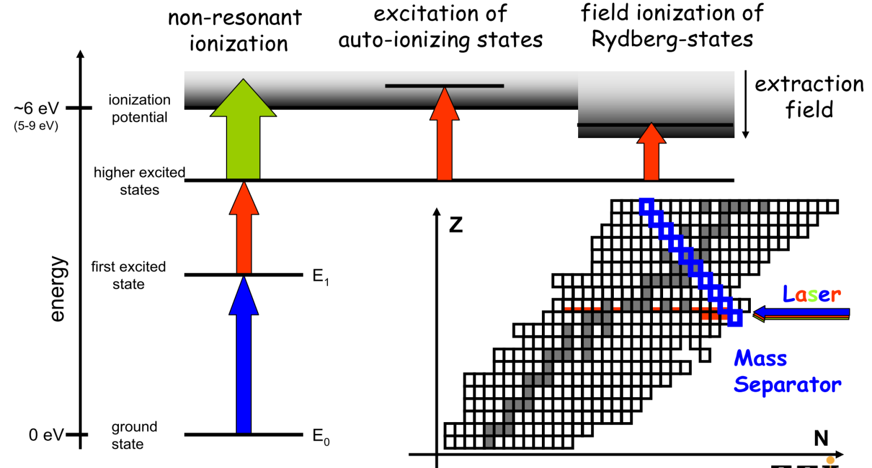
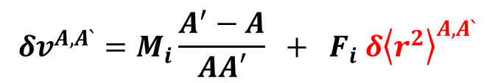
Selective Resonance Laser Spectroscopy of an atom (even-even nuclei)
ν₃
ν₂
δν∼1:10⁶ (tiny, but measurable frequency shift, if lasers are used!)
ν₁
ν₁’
ν₁’’
¹⁸²Hg (N=102)
¹⁸⁴Hg (N=104)
¹⁸⁶Hg (N=106)
_{Iions}
Ionization Frequency shift δν=ν₁-ν₁’: Isotope Shift (IS) or HFS
IS/HFS proportional to the charge radius
ν₁
ν₁’
ν₁’’
$$δv^{A,A`}=M_{i}\frac{A^{′}−A}{AA′} + F_{i} δ{\left\langle r^{2}\right\rangle }^{A,A`}$$
Mass shift
Field shift

Slide 26
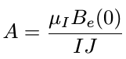
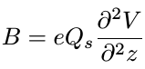
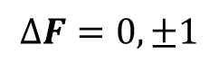
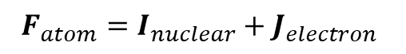
Resonance Laser Spectroscopy of an odd-A nucleus
C = F(F +
1) − I (I + 1) − J (J + 1)
A single peak in ‘optical/frequency’ spectra for even-even nuclei
More complex in odd-A (odd-odd-A) cases, need to consider Hyperfine Splitting (HFS), due to coupling of nuclear I and electron spin J, giving a total atomic spin F=I+J
This often results in many peaks in the frequency spectrum
¹⁷⁸Hg(I=0) ¹⁷⁹Hg(I=7/2)
$$F_{atom}=I_{nuclear}+J_{electron}$$
$$∆F=0,±1$$
The method allows to deduce magnetic (μ) and quadrupole (Q_{s}) momenta of the nucleus!

Slide 27
Schemes of Atomic Resonance Ionization used with Cu-Vapor Laser
Available lasers: visible light, 2-3 eV photon energy: need multi-step Ionisation!
Li (5.39 eV)
Na (5.14 eV)
Sr (5.69 eV)
Ce (5.54 eV)
Nd (5.52 eV)
Sm (5.64 eV)
Eu (5.67 eV)
Gd (6.15 eV)
Tb (5.86 eV)
Ho (6.02 eV)
Tm (6.18 eV)
Yb (6.25 eV)
Lu (5.43 eV)
Actinides… (at Mainz)
Mg (7.65 eV)
Mn (7.43 eV)
Co (7.86 eV)
Ni (7.64 eV)
Cu (7.73 eV)
Y (6.22 eV)
Ag (7.58 eV)
Tc (7.28 eV)
Sn (7.34 eV)
Pb (7.42 eV)
Bi (7.29 eV)
Al (5.99 eV)
Ca (6.11 eV)
Ga (6.00 eV)
In (5.79 eV)
Tl (6.11 eV)
Cu (7.73 eV)
Be (9.32 eV)
Zn (9.39 eV)
Cd (8.99 eV)
Be (9.32 eV)

Slide 28
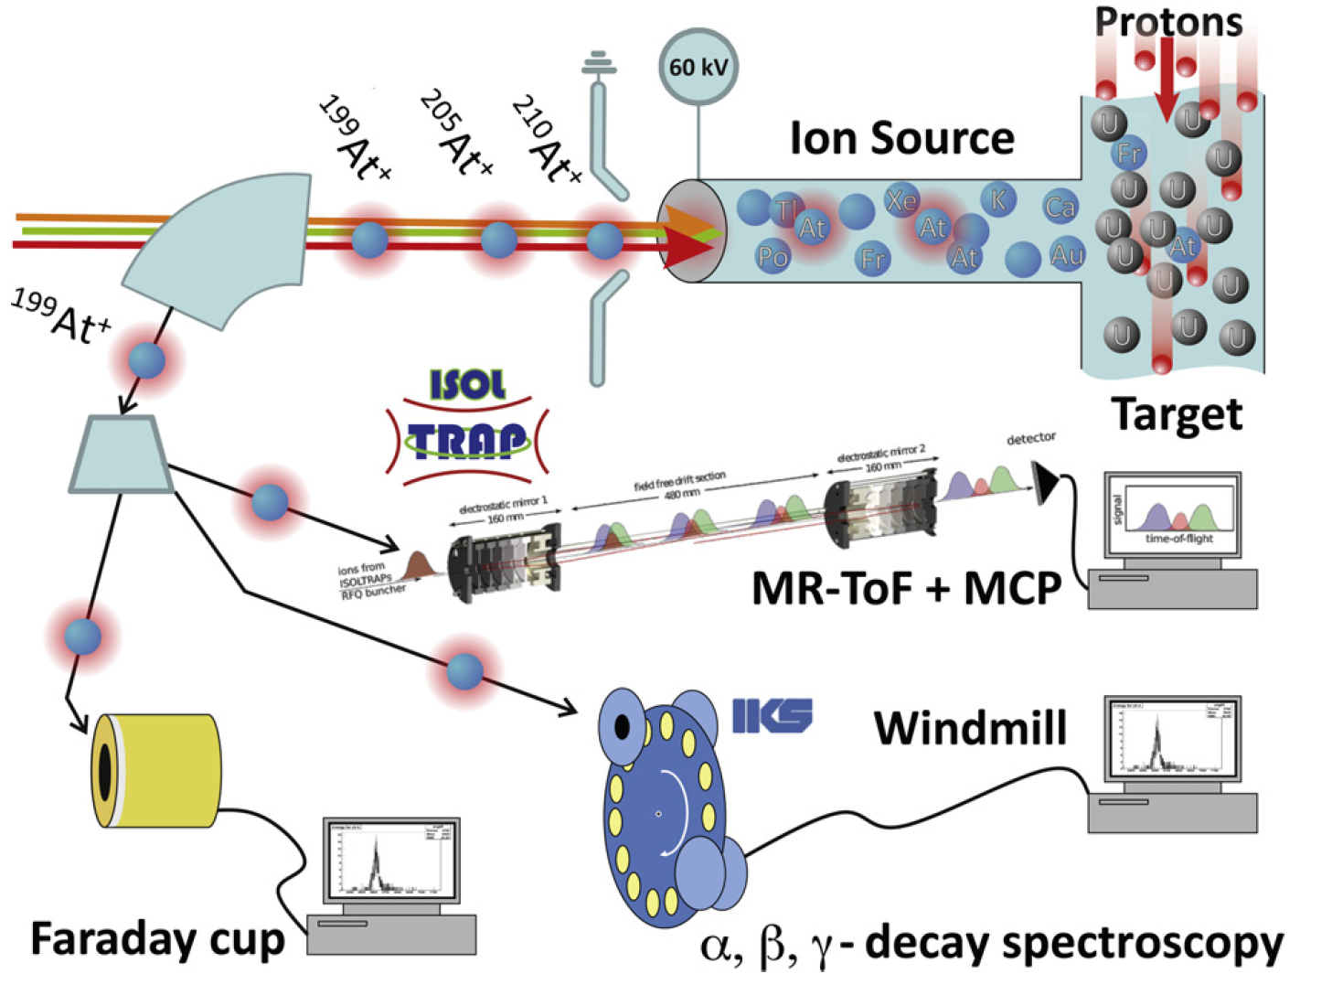
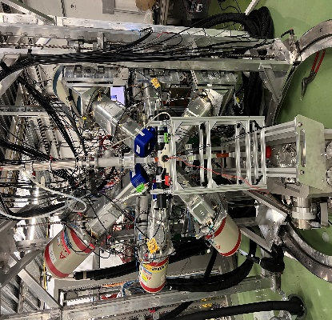
Our tools for in-source Laser Spectroscopy at ISOLDE
B. A. Marsh et al., 20013 EMIS conference, NIM B317, p.550 (2013)
MR-ToF MS: R. N. Wolf et al, NIM, A686, 82 (2012)
²¹⁰Hg⁺
²⁰⁹Hg⁺
²⁰⁸Hg⁺
Hot Ion Source
²⁰⁹Hg⁺
ISOLDE Decay Station (IDS)

Slide 29
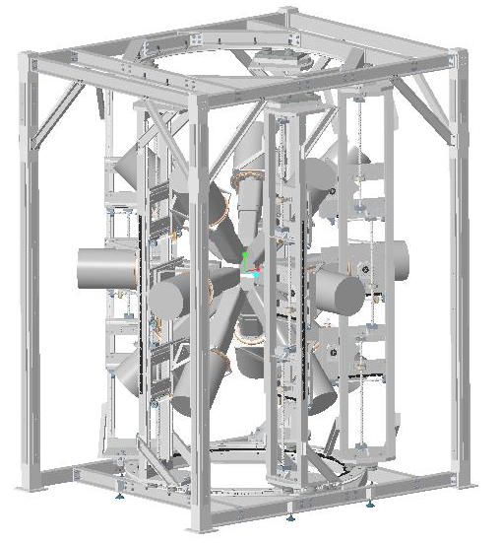
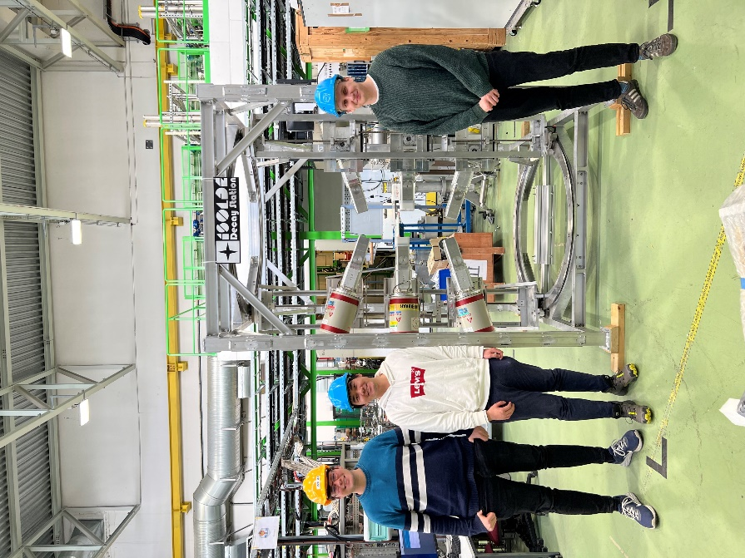
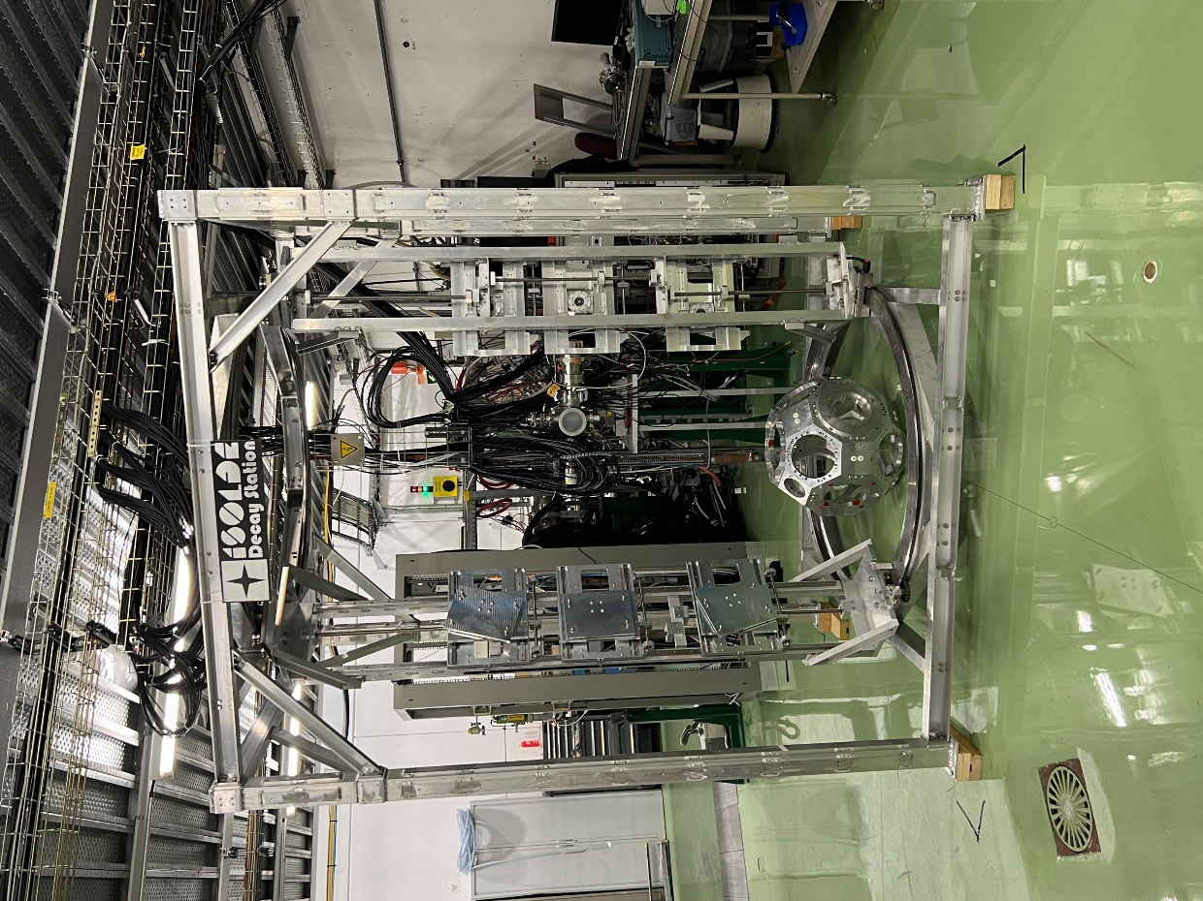

ISOLDE Decay Station
https://isolde-ids.web.cern.ch/
Collaboration of 14 institutes worldwide (Further collaborations are welcome)
IDS fame can hold up to 15 clovers on 5 gantries

Slide 30
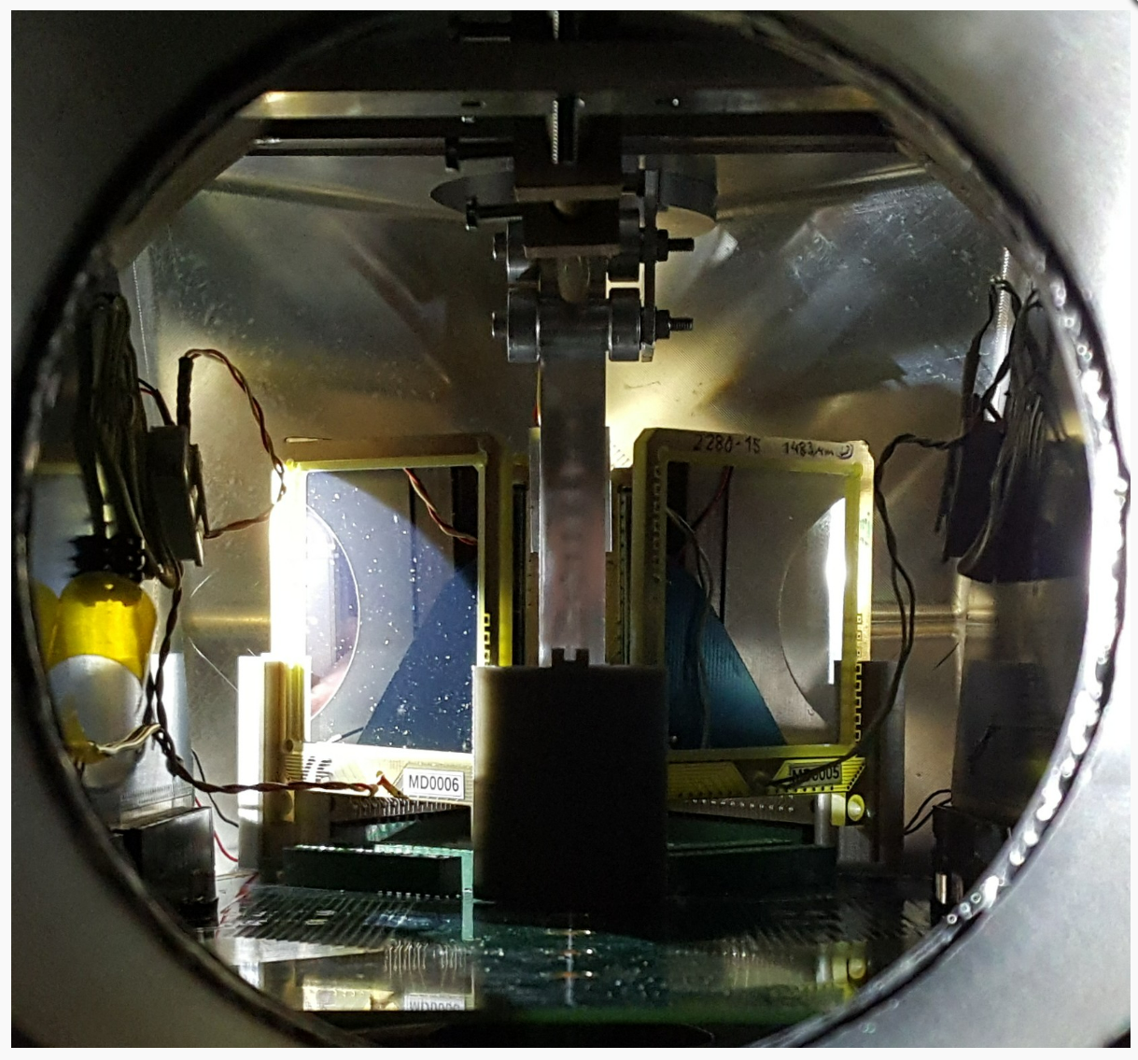
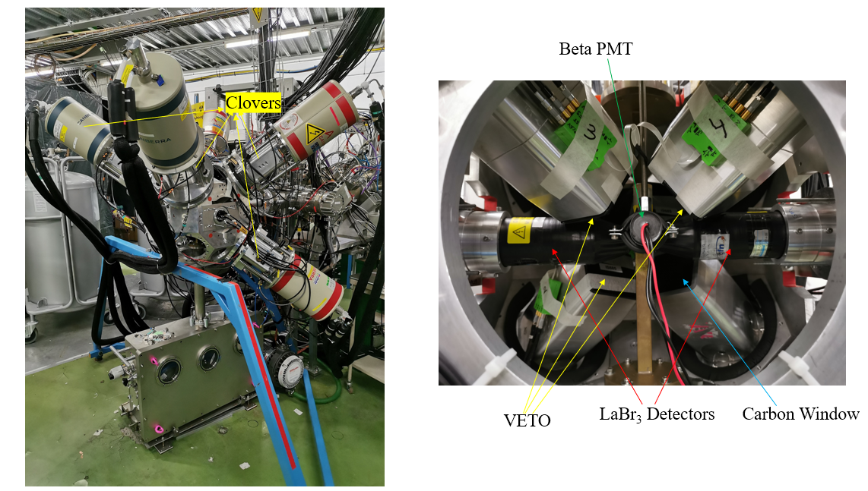
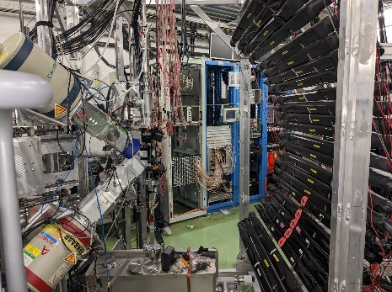
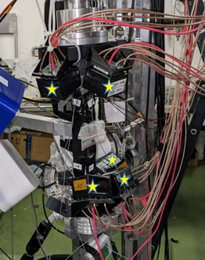
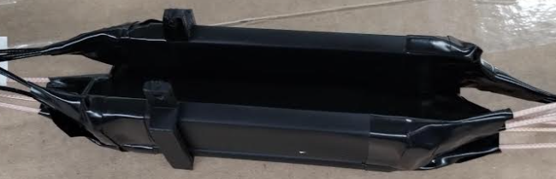
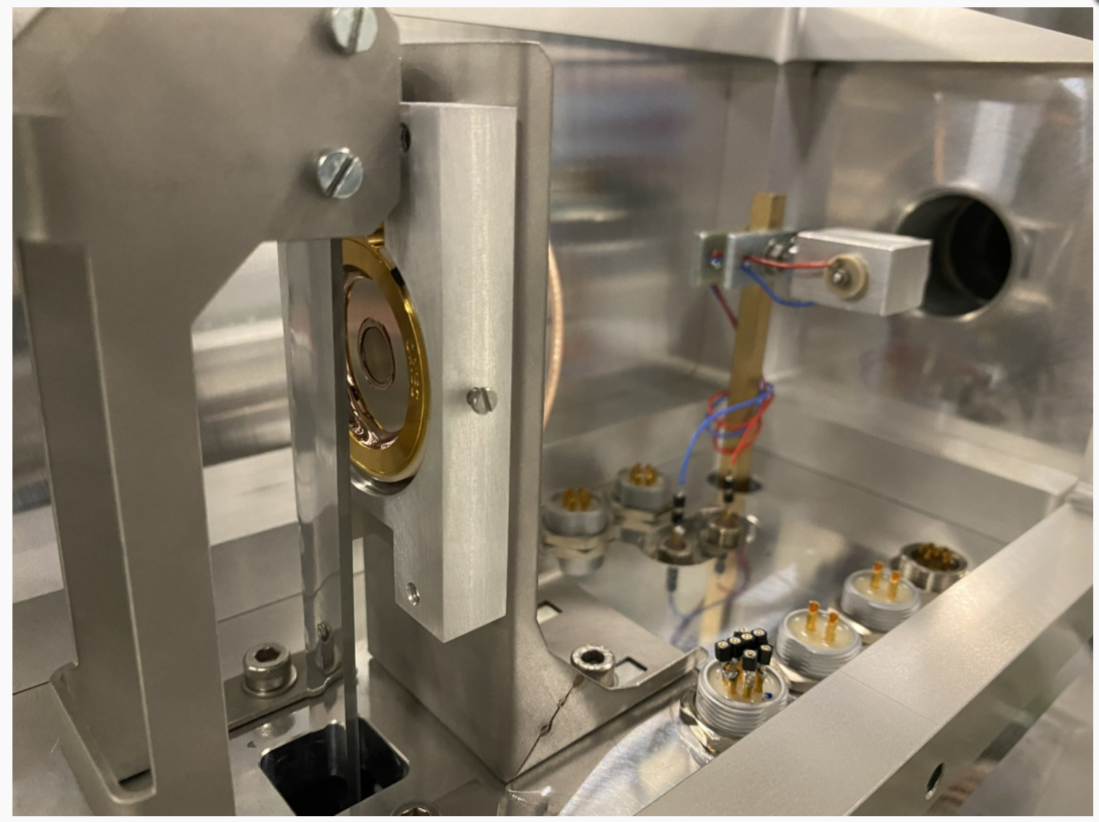
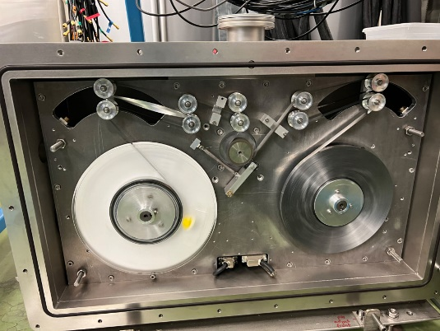
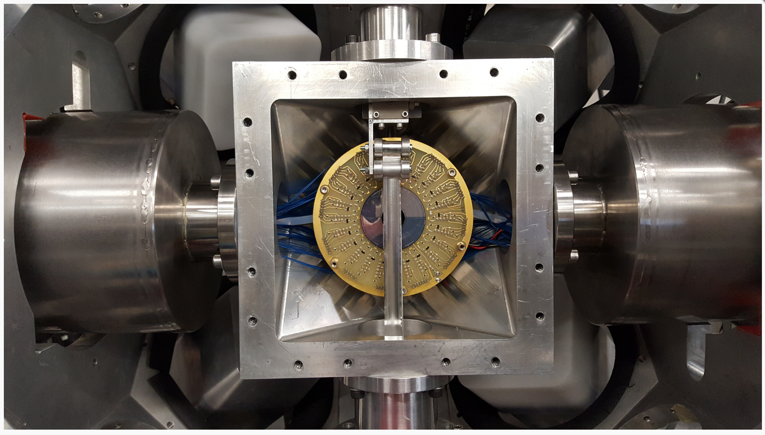

Zoo of IDS detectors
alpha
Beta-gamma
Neutrons
DSSDs and Si PADs
Fast-timing (LaBr3; beta scintillator; clovers)
INDiE bars and OGS neutron detectors
Conversion electron
Annular Si with Tape
SPEDE
Si pins and Solar cell
Tape station
https://isolde-ids.web.cern.ch/

Slide 31



Multi-Reflection Time-of-Flight (MR-ToF) Spectrometer for HFS studies and mass measurements
The IDS technique requires waiting for the decay of the isotope. Not practical for long-lived or stable isotopes.
Alternative – to use ‘counting’ ions (instead of waiting for decay)
MR-ToF MS: R. N. Wolf et al, NIM, A686, 82 (2012)

Slide 32

Example for neutron-deficient Hg isotopes (or, what happens after shape staggering in ¹⁸¹⁻¹⁸⁵Hg?)
Large IS between ^{183,185}Hg and ¹⁸⁷Hg
J. Bonn et al, PLB38, 308 (1972)
R. Julin, K. Helariutta, M. Muikku, J. Phys. G 27 (2001)
Even-Even Hg
Previous Hg radii data (ISOLDE)
^{183,185,187,199,201}Hg: J. Bonn et al, PLB38, 308 (1972)
¹⁸¹⁻¹⁹¹Hg: J. Bonn et al., ZPhys A 276, 203 (1976)
¹⁸²⁻¹⁹⁸Hg: G. Ulm Z. Phys. A 325, 247 259 (1986)
Note: gs of ^{182,184,186}Hg – weakly oblate
In-beam Hg data - examples (RDT, plunger, Coulex)
^{184,186}Hg; L.P. Gaffney LP et al. PRC89 024307(2014)
¹⁷²Hg: M. Sandzelius et al, PRC79, 064315 (2009)
¹⁷⁵Hg: D. O’Donnell et al., PRC79, 051304(2009)
^{176,178}Hg: M. P. Carpenter et al, PRL78, 3650(1997)
¹⁷⁶Hg: M. Muikku et al, PRC58, 3033 (1998)
^{180,182}Hg: T. Grahn et al, PRC80, 014324 (2009)

Slide 33



¹⁸⁰Hg
Alpha-decay spectrum at A=180 (lasers on ¹⁸⁰Hg)
note the purity of the spectrum
¹⁷⁶Pt
¹⁸⁰Hg
Optical spectrum (even-even case, I=0⁺)
(number of α decays as a function of laser frequency)

Slide 34


¹⁸¹Hg
Alpha-decay spectrum at A=181 (lasers on ¹⁸¹Hg)
HFS spectrum (I=1/2)

Slide 35



^{179,185,207,208}Hg
Isotopes with N>126
²⁰⁷Hg HFS spectra@MR-ToF, I=9/2
also ²⁰⁸Hg! I=0
¹⁸⁵Hg HFS spectrum@MR-ToF, gs+is
²⁰⁸Hg

Slide 36




HFS spectra and Charge radii for Hg isotopes B.A. Marsh et al., Nature Physics, 1745-2481 (2018)
‘deformed (prolate)’
oblatish
^{181,183,185}Hg- confirmation of earlier data on staggering for ½⁻ gs
^{177,178,179,180}Hg (new) – trend towards sphericity
^{207,208}Hg (new): kink beyond N=126

Slide 37


B.A. Marsh et al., Nature Physics, 1745-2481 (2018)
One for the funding councils →
S. Sels et al., Phys. Rev. C 99, 044306 (2019)
One with the interesting work in →
N>126 region : T. Day Goodacre et al., PRL 126, 032502 (2021) T. Day Goodacre et al., PRC 104, 054322 (2021)

Slide 38
MCSM for Hg isotopes (Y. Tsunoda, T.Otsuka et al)
(B. Marsh et al, Nature Physics, Oct 2018)
Performed by Takaharu Otsuka’s team
Largest calculation of its kind, avoids diagonalization of >2x10⁴²-dimensional H matrix
Radii are well reproduced.
Results show an increase of >2 protons promoted into the h9/2 intruder state.

Slide 39
Density Functional Theory (DTF) Potential Energy Calculations (York-Lyon-Brussels Collaboration)
Extensive Density Functional Theory blocked calculations performed by York-Lyon-Brussels Collaboration (14 parametrizations of Skyrme functional were probed)
UNEDF0, UNDEF1, UNDED1^{SO}, SLy4, SkM*, SGII
8 parametrizations of SLy5sX
Variation of pairng strength and other parameters
Full account in S.Sels et al, PRC, 2019

Slide 40





Charge radii for Hg isotopes (reduced pairing and blocking for odd-A)
Courtesy A. Pastore and J. Dobaczewski (York)
SLy4
Mean-field theory summary (AP+JD):
The phenomenon of the radii staggering in Hg is a subtle effect of an interplay between (i) shape coexistence, (ii) pairing strength, and (iii) deformed shell structure
The presently available functionals do not allow for reuniting these three aspects in a consistent way (e.g. spins are not reproduced), although the essential features of the effect can be reproduced…”
SLy4
SkM*
UNEDEF0
UNEDEF1

Slide 41

‘Schematic explanation’: Sphericity vs Deformation around N=104
A.Andreyev et al, Nature 405, 430 (2000)
Large IS between ^{183,185}Hg and ¹⁸⁷Hg
J. Bonn et al, PLB38, 308 (1972)
¹⁸⁶Pb (Z-82, N=104)

Slide 42

2025’ Radii systematics in the Lead region
Red symbols:
our data from ISOLDE
IS/HFS/charge radii for >70 isotopes (and isomers) for Au,Hg,Pb,Bi,Po, At
Back to sphericity” in the lightest Au and Hg isotopes
Magnetic/quadrupole moments will be deduced
Large amount of by-product nuclear spectroscopic information on parents and their daughters products

Slide 43
R-process network calculations
r-プロセス元素合成の動画
²³²Th,²³⁸U
¹³²Sn
⁷⁸Ni
和南城伸也氏（上智大）
R-process network calculations require data for very neutron-rich nuclei: half-lives, decay modes, neutron-capture cross sections, fission barriers and mass distributions.

Slide 44

ISOLDE studies of neutron-rich isotopes around N=126
One of the least experimentally explored regions of nuclear chart – “Terra incognita” for nuclear and laser spectroscopy, especially below Z=82
Some available decay data primarily from in-beam and isomer-decay studies at GSI/RIBF.
Hyperfine structure + isotope shift (radii/moments at ISOLDE)
Masses are largely unknown below Z=82 (ISOLDE/ESR-GSI)
N=126

Slide 45



The N=126 kink in charge radii across the Chart of Nuclei
Sudden increase of the slope in δ<r²> when crossing a shell closure
– seen all over nuclear chart
K. Kreim et al. Physics Letters B 731 (2014) 97–102
P. Campbell et al. Prog. in Part. & Nuc. Phys. 86 (2016) 127–180
N=28
N=50
N=82
N=126
V.S. Letokhov et al 1992 J. Phys. G: Nucl. Part. Phys. 18 1177

Slide 46
Let’s start with some ‘classics’
In standard SM, neutron g9/2 is always
below i11/2!

Slide 47

(In)Famous Kink at N=126 – Theoretical description
Number of theoretical attempts at describing the kink: P.M. Goddard et al., PRL 110, 032503 (2013) H. Nakada & T. Inakura, PRC 91, 021302(R) (2015) H. Nakada, PRC 92, 044307 (2015)
…..
All invoke a significant occupation of νi_{11/2} orbital
Not consistent with the classical shell model and experiment, which require first g9/2 to be occupied!
E.g. ²⁰⁹Pb and ²¹¹Po have magnetic moments consistent with pure νg_{9/2} states
H. Nakada, PRC 92, 044307 (2015)

Slide 48




Role of 1i11/2 neutron occupancy on the kink around the lead region?
Overlap of 1i_{11/2} significantly > 2g_{9/2}
Occupation of the neutron 1h_{11/2} orbital provides a better overlap with majority of n=1 proton orbitals (via symmetry energy), thus driving them to a larger radius?

Slide 49


Role of 1i11/2 neutron occupancy on the kink around the lead region?
Skyrme, P.M. Goddard et al,PRL110 (2013)
Relativistic, T. Day Goodacre et al,PRL126(2021)&PRC104(2021)
Pb
It seems the models in which the i11/2 neutron orbital is below g9/2 (or very close to it)
reproduce the kink better, due to enhanced population of the i11/2 orbital. In particular, this is a common property of relativistic approaches.

Slide 50
Goal: High-spin isomers ^{212m1,m2,213m}Bi and the N=126 kink problem (successful experiment on 3-9 December 2025)
Properties of the high-spin isomers ^{212m1,m2,213m}Bi and their link to the kink in Bi gs charge radii at N=126: is the position and occupation of the i11/2 neutron orbital a real culprit for the N=126 kink?
Skyrme, P.M. Goddard et al,PRL110 (2013)
Relativistic, T. Day Goodacre et al, PRC104,054322(2021)
This effect can be probed by charge radii of high-spin isomers in ^{212m2,213m}Bi, whose configuration presumably includes an i11/2 neutron:
^{212m2}Bi [πh9/2×((νg9/2)²×νi11/2)]18–,
^{213m}Bi [πh9/2× (νg9/2×νi11/2)]25/2–,
relative to their gs’s or ^{212m1}Bi [πh9/2×νg9/2)]8–,9–, which have no i11/2 neutrons.
Pb
It seems the models in which the i11/2 neutron orbital is below g9/2 (or very close to it)
reproduce the kink better, due to enhanced population of the i11/2 orbital. This is a common property of relativistic approaches.

Slide 51

The N=126 kink in charge radii and magnetic moments in the neutron-rich Tl (Z=81) isotopes

Slide 52






The N=126 kink in charge radii of Tl (Z=81) isotopes
Fr Isobaric contamination is our main enemy at masses A=207-212 and A>219!!!
Ohmic heating
2000 degrees
Fr isobaric contaminations!
ISOLDE Yield Database
Isotope | ²⁰⁹Fr | ²⁰⁹Tl
Yield (/μC) | 2.5×10⁷ | 3.2×10²
Mass Number | 207 | 208 | 209
Half-life of Fr | 14.8s | 58.6s | 50s
Half-life of Tl | 4.77m | 3.05m | 2.16m

Slide 53


The Laser Ion Source and Trap (LIST) at ISOLDE
(efficient suppression of surface-ionized species, e.g. alcalii)
LIST structure
Ionization cavity
90 mm
Ion repeller electrode
Target
To experiment
Spatial separation: hot cavity ↔ laser ionization volume
Suppress the ions produced via surface ionization (by a factor of ~10000)
Only lose the isotope of interest (by a factor of 10-15)
Suppression of surface ionized species
Pure laser ionization inside RF quadrupole structure

Slide 54




HFS/IS, charge radii for neutron-rich Tl isotopes
(Z. Yue , A.A. et al., PRC, 2024)
First time!
First time!
210Tl should be possible, but difficult to move heavier at ISOLDE, rate and contaminations issues.
(RIBF can reach to 215Tl, see PRL 2024 from RIBF)

Slide 55





Magnetic dipole moments for neutron-rich Tl isotopes
(Z. Yue et al., PLB849, 2024)
4085 keV
2⁺
803 keV
799 keV
~66%
2⁺
2⁺
Mixed configurations
0⁺
0⁺
0⁺
Maximum at N=126
²⁰⁶Pb
²⁰⁸Pb
²¹⁰Pb
Reproduced the jump
Ground and 2⁺ excited states of Pb isotopes
Way below Schmidt value
Theory of TFFS
J. Bonnard, J. Dobaczewski, et al, Phys. Lett. B 843 (2023) 138014,
Theory of finite-Fermi systems (TFFS)
Phonon coupling →jump at N = 126
Calculated μ for ^{207g}Tl matches nicely with experimental data
Skyrme-EDF
Good agreement in describing the Eu and Tl 11/2⁻ isomers

Slide 56

Neutron-rich Hg isotopes at ISOLDE

Slide 57






Hg Physics motivation – configurations, log ft, T1/2, (P_{n})
Competition between allowed and first forbidden β decays due to single particle orbits near Fermi surface
T_{1/2} , log ft, P_{n} place constraints on models used for r-process network calculations
Little available data primarily from in-beam and isomer-decay studies
β decay schemes of ^{210,211}Hg unknown
Conflicting results for ²⁰⁹Hg decay
Hyperfine structure + isotope shift measurements will provide radii and moments data
Strong theoretical effort- large scale shell model calculations log ft for FF decays
Isotope | T_{1/2} Lanzhou | T_{1/2} GSI | T_{1/2} ISOLDE
²⁰⁸Hg | ${41}_{−4}^{+5}$min [1] | $132.2±50.0$ s [3] | $135±10$ s [4]
²⁰⁹Hg | ${35}_{−6}^{+9}$s [2] | $6.3±1.1$ s [3] | $$−$$
²¹⁰Hg | $$−$$ | $$−$$ | $$−$$
²¹¹Hg | $$−$$ | $$−$$ | $$−$$
[1] L. Zhang et al., CPL 14, 507 (1997); [2] Zhang Li et al., PRC 58, 156 (1998); [3] R. Caballero-Folch et al., PRC 95, 064322 (2017); [4] R. J. Carroll et al. PRL 125, 192501 (2020).
Lanzhou, decay Zhang Li et al., PRC 58, 156 (1998)
GSI, isomer
N. Al-Dahan et al., PRC 80, 061302(R) (2009).

Slide 58






Hg Physics motivation – masses
So far, only measured up to ²⁰⁸Hg – values in AME for more neutron-rich cases extrapolated from systematic trends (large uncertainties).
Study trend in S_{2n} beyond N=126 in Z<82 region, use $Δ$S_{2n} to probe weakening of N=126 closure
Explore interaction strength between last proton and neutron, $δV_{pn}$, in poorly studied region.
Derived mass excess important for restricting nuclear mass models - input for r-process network calculations.
Requires ~50 keV precision [J. Clark et al., EPJA 59, 204 (2023)]
$$δV_{pn}\left(Z,N\right)=\frac{1}{4}[\left\{B\left(Z,N\right)−B(Z−2,N)\right\} −\left\{B\left(Z−2,N\right)−B(Z−2,N−2)\right\}]$$

Slide 59

LOI244 – test for neutron-rich Hg’s
6 shifts, quartz transfer line
A.Andreyev et al, LoI244
Very strong contamination
from isobaric surface-ionized Fr
We use cold quartz transfer line

Slide 60


LOI244 – test for neutron-rich Hg’s
6 shifts, quartz transfer line
Decay measurements ²⁰⁹⁻²¹¹Hg – Brand new results!
No evidence of contaminants – suppressed or too long-lived
Clear difference in lasers on/off data – presence of laser ionised Hg
High enough rates for dedicated laser and decay studies
Preliminary data indicates previous decay schemes for ²⁰⁹Hg is not correct
Mass spectra for ^{209,210}Hg with MR-ToF – First ever measurements!
Recorded ~7 ions per shot.
Data contain systematic shifts due to space-charge effects – unquantifiable effect in this dataset
Quartz line used for experiment before – observed contamination possibly due to some saturation of the line
Beta-tagged germanium data
Red = lasers on, Black = lasers off
Run times = 0.6 hrs, 0.25 hrs
A=209
Some new
7.3 hrs, 1.0 hrs
A=210
All new
4.4 hrs, 1.7 hrs
A=211
All new
Isotope | Yield estimate from LoI244 [ions/μC] | Decay | Mass | Laser
²⁰⁹Hg | 4(1) | ● | ● | ●
²¹⁰Hg | 4(1) | ● | ● | ●
²¹¹Hg | 0.5(1) | ● | Will try | Will try
²¹²Hg | n/a | Will try | Will try | Will try
A.Andreyev et al, LoI244
J.Cubiss at all, accepted proposal

Slide 61

Summary
Neutron-rich Tl-Bi nuclei are one of the least experimentally explored regions of nuclear chart – “Terra incognita” for nuclear and laser spectroscopy
However, several techniques are still available to access this region, in particular fragmentation reactions at ISOLDE, GSI-FRS and RIBF-RIKEN.
Complementary data can be obtained, such as radii/moments (ISOLDE), short-lived isomers (GSI/RIKEN), beta-gamma, fast timing…
Red data = our data from ISOLDE
Green points = Gatchina
Black points = literature

Slide 62
Thank you!

Slide 63
Role of 1i11/2 neutron occupancy on the kink around the lead region?
P. M. Goddard et al. PRL 110, 032503 (2013)
Overlap of 1i_{11/2} significantly > 2g_{9/2}

Slide 64
Goal: High-spin isomers ^{212m1,m2,213m}Bi and the N=126 kink problem
Properties of the high-spin isomers ^{212m1,m2,213m}Bi and their link to the kink in Bi gs charge radii at N=126: is the position and occupation of the i11/2 neutron orbital a real culprit for the N=126 kink?
Skyrme, P.M. Goddard et al,PRL110 (2013)
Relativistic, T. Day Goodacre et al, PRC104,054322(2021)
This effect can be probed by charge radii of high-spin isomers in ^{212m2,213m}Bi, whose configuration presumably includes an i11/2 neutron:
^{212m2}Bi [πh9/2×((νg9/2)²×νi11/2)]18–,
^{213m}Bi [πh9/2× (νg9/2×νi11/2)]25/2–,
relative to their gs’s or ^{212m1}Bi [πh9/2×νg9/2)]8–,9–, which have no i11/2 neutrons.
Pb
It seems the models in which the i11/2 neutron orbital is below g9/2 (or very close to it)
reproduce the kink better, due to enhanced population of the i11/2 orbital. This is a common property of relativistic approaches.

Slide 65


^{212g,m1,m2}Bi (N=129)
^{213g,m}Bi (N=130)
^{213g}Bi
^{212g}Bi
^{212m1}Bi
^{213m}Bi
L. Chen et al.,
^{212m2}Bi
^{212m2}Bi [πh9/2×((νg9/2)²×νi11/2)]18– ???
^{213m}Bi [πh9/2× (νg9/2×νi11/2)]25/2– ???

Slide 66


HFB calcs.: odd-A and odd-odd nuclei
Odd-A, and particularly odd-odd nuclei are a challenge for theory
HFB using D1M-Gogny (S. Goriely et al., PRL 102, 242501 (2009).).
Begin by selecting states with correct spin, and calculating ground state.
Th.
Th.
10

Slide 67






HFB for Bismuth
A.E. Barzakh et al., PRL 127, 192501 (2021) S. Péru et al., PRC 104, 024328 (2021)
Candidate states were selected by: Correct spin, agreement with μ, <1 MeV
Configuration mixing across deformation surface introduced: $\left\langle 𝒪\right\rangle =\frac{\int_{q}{𝒪exp\left({−E}/T\right)dq}}{\int_{q}{exp\left({−E}/T\right)dq}}$
11

Slide 68

Charge-radii across the lead region, from Au to At (Z=79 to 85)
J.G. Cubiss et al., Phys. Rev. Lett. 131, 202501 (2023)
Try applying same approach to proton-rich ground states of all chains we have measured (Z=79-85, $≈$160 isotopes)
All results here include mixing, using same statistical approach
12

Slide 69

Charge-radii across the lead region, from Au to At (Z=79 to 85)
J.G. Cubiss et al., Phys. Rev. Lett. 131, 202501 (2023)
Try applying same approach to proton-rich ground states of all chains we have measured (Z=79-85, $≈$160 isotopes)
All results here include mixing, using same statistical approach
12

Slide 70

Charge-radii across the lead region, from Au to At (Z=79 to 85)
J.G. Cubiss et al., Phys. Rev. Lett. 131, 202501 (2023)
Try applying same approach to proton-rich ground states of all chains we have measured (Z=79-85, $≈$160 isotopes)
All results here include mixing, using same statistical approach
12

Slide 71


The Kink at N=126 – (some of) theoretical description
Number of theoretical attempts at describing this: P.M. Goddard et al., PRL 110, 032503 (2013) H. Nakada & T. Inakura, PRC 91, 021302(R) (2015) H. Nakada, PRC 92, 044307 (2015)
All invoke a significant occupation of νi_{11/2} orbital
Not consistent with experiment! ²⁰⁹Pb and ²¹¹Po have magnetic moments consistent with pure νg_{9/2} states
H. Nakada, PRC 92, 044307 (2015)
Pb
Po
P.M. Goddard et al., PRL 110, 032503 (2013)

Slide 72
¹⁸⁸Bi: Isomer separation
Comparison of α-decay spectra for different laser modes: broad bandwidth, narrow bandwidth for high-spin isomer, narrow bandwidth for low-spin isomer.
Courtesy Boris Andel (to be submitted soon)

Slide 73




Example on Isomer Selectivity in ^{178gs,m}Au
J.G. Cubiss (York) et al., in preparation
Gate on gs peaks 3-4
HFS
gs
}
Gate on isomer peaks 1,2,5,6
Masses of gs and m
GS: Only low-spin states, up to 4⁺
Isomer: Feeding up to 8⁺
Opens up a totally new area of reactions studies with isomerically-clean beams! (e.g. spin-dependence of reactions, in this case with low spin ground state or with high-spin isomeric beam)

Slide 74

How to get to N=126 nuclei (and beyond)?
Y.X. Watanabe et al, Phys. Rev. Lett. 115, 172503
136Xe+198Pt
GSI/RIKEN-method, inverse kinematics,
relativistic RIBs
ISOLDE: p(1.4 GeV)+238U
208Pb(1 GeV/u)+Be

Slide 75
Comparison Hg vs Pb chains
S.Sels et al, PRC 2019

Slide 76


DFT Potential Energy Surfaces (even-even Hg’s)
SLy4
SkM*
UNEDEF0
UNEDEF1
Coutresy A. Pastore and J. Dobaczewski (York), S. Sels et al, PRC, 2019

Slide 77



Summary
In-source laser spec. powerful and versatile tool - Extensive campaign performed throughout Pb region - Unique sensitivity vital for most exotic cases - Wealth of spectroscopic info. to challenge models
“Global” models do much better than expected - Candidate states present for all ground states - Magnetic moments powerful identifying tool - Shape mixing at microscopic level needs introducing
Kink phenomenon still needs exploring - Different mechanisms proposed for producing trend, RMF and Fayans calculations look very promising - Moments of odd-N cases could be key - High-spin Bi isomers experiment to provide further tests - Search for global Fayans parameterisation ongoing
Still much to learn and explore - LIST opens up new opportunities in n-rich region - Still plenty to explore, to learn and fun to be had.
Red data = our data from ISOLDE
Green points = Gatchina
Black points = literature

Slide 78
Shape Coexistence in Nuclei (a brief introduction)

Slide 79

Spherical Doubly-Magic ¹⁶O (Z=N=8)
0⁺ Ground State 0p-0h Spherical configuration
Protons π Neutrons ν
1d_{5/2}
1d_{5/2}
8
8
1p_{1/2}
1p_{1/2}
1p_{3/2}
1p_{3/2}
1s_{1/2}
1s_{1/2}
0p-0h (sph)
0p-0h (sph)
H. Morinaga, Phys. Lett., 101, 254(1956)

Slide 80
Rotational Band in Doubly-Magic ¹⁶O?
0⁺ Ground State 0p-0h Spherical configuration
Protons π Neutrons ν
1d_{5/2}
1d_{5/2}
8
8
1p_{1/2}
1p_{1/2}
1p_{3/2}
1p_{3/2}
1s_{1/2}
1s_{1/2}
0p-0h (sph)
0p-0h (sph)
H. Morinaga, Phys. Lett., 101, 254(1956)

Slide 81

Shape Coexistence in Doubly-Magic ¹⁶O (Z=N=8) (intruder states)
0⁺ Ground State 0p-0h Spherical configuration
4p-4h
Protons π Neutrons ν
1d_{5/2}
1d_{5/2}
8
8
1p_{1/2}
1p_{1/2}
1p_{3/2}
1p_{3/2}
1s_{1/2}
1s_{1/2}
0⁺ Excited State 4p-4h Deformed configuration
Protons π Neutrons ν
1d_{5/2}
1d_{5/2}
8
8
1p_{1/2}
1p_{1/2}
π2p2h⊗ν2p2h
1p_{3/2}
1p_{3/2}
0p-0h (sph)
1s_{1/2}
1s_{1/2}
0p-0h (sph)
H. Morinaga, Phys. Lett., 101, 254(1956)

Slide 82


3 coexisting shapes in Doubly-Magic ⁴⁰Ca (Z=N=20)
8p-8h

Slide 83

Shape coexistence around closed proton and/or neutron shells (and subshells)
spherical and deformed structures co-exist in the nucleus at low energy
its study can contribute in finding a unified description for atomic nuclei
supplies information about the mixing between these configurations
¹⁸⁶Pb₁₀₄
Cd-Sn region
⁴⁰Ca₂₀
Lead region
¹⁶O₈
⁴⁰Mg⁻⁴²Si-⁴⁴S-⁴⁶Ar (disappearance of N=28)
³²Mg (island of inversion around N=20)
Spherical
Oblate
Prolate
K. Heyde and J. Wood, Review of Modern Physics, 83, 1467 (2011)

Slide 84


Nilsson Diagrams around Z~82 & 82<N<126 (WS)
Protons
Neutrons
82
Proton single-particle levels (MeV)
Neutron single-particle levels (MeV)
Deformation β₂
Deformation β₂
Around Z=82 and neutron mid-shell N=102-108, protons and neutrons
coherently produce low-lying coexisting oblate and prolate shapes
Spherical
Oblate
Prolate

Slide 85
IS534@ISOLDE: Charge radii of Au isotopes
Are the light gold isotopes
deformed, A(Au)<183?
What are the spins of ground
and isomeric states?
Au?
Previous radii data (ISOLDE)
¹⁸⁵⁻¹⁹⁰Au : K. Wallmeroth et al, NPA493,224 (1989)
^{183,184}Au: U. Kronert et al, Z.Phys. A331, 521 (1988)
^{184mg}Au: F. Le Blanc et al. PRL79, 2213 (1997)

Slide 86


HFS spectra and Charge Radii for Au
J. G. Cubiss, A. Andreyev et al., PRL 131, 202501 (2023)
¹⁸⁰⁻¹⁸²Au- stay strongly deformed
^{176mg,177mg,179}Au – trend towards sphericity
^{178mg}Au: both isomers are deformed

Slide 87


Shape Staggering in ¹⁸⁷⁻¹⁸⁹Bi
A.E. Barzakh, A.Andreyev et al., PRL 127, 192501 (2021)
Bi
PhD project of Chris Rasion (York)
^{187,189-209}Bi – follow the spherical Pb trend
^{188m,g}Bi (N=105) – Large stagger!
Kink at N=126 observed

Slide 88

Charge radii for Hg, Au and Bi
The sudden jump in ¹⁸⁸Bi happens at the same neutron number N=105 as in odd-A Hg’s

Slide 89


(An example) Modern ‘state-of-the art’ beyond mean-field calculations (SLy6+GCM)
J.M.Yao, M. Bender, P.-H. Heenen, PRC87,034322(2013)
R. Julin, K. Helariutta, M. Muikku, J. Phys. G 27 (2001)
‘deformed (prolate)’
oblatish

Slide 90

(In)Famous Kink at N=126
Slope in δ<r²> seen to increase when passing N=126
Seen in elements both above and below Z=82
Effect is seen in both odd- and even-n nuclei
A.E. Barzakh et al., PRC 97, 014322 (2018)

Slide 91


(In)Famous Kink at N=126?
Pb
Po
Occupation of the neutron 1h_{11/2} orbital provides a better overlap with majority of n=1 proton orbitals (via symmetry energy), thus driving them to a larger radius?

